Slide 1
X!Plore
Learning Chat Room
Team: cd-105

Slide 2
Topics to cover today
What is X!Plore
System Overview
Technical Features
A feasible use case scenario
Design Decision--Parsing
Performance Evaluation
Notes:
need to mention our focus of the presentation before the agenda

Slide 3
What is X!Plore?
A simplified, chat room style forum
A place for students to ask/answer questions
Notes:
storage server, acting like a chat room

Slide 4
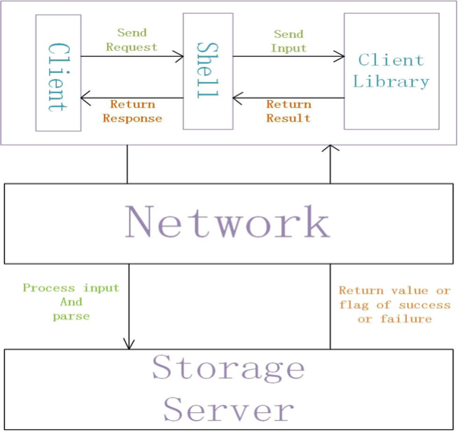
System Overview

Slide 5
Technical Features
Data structure: Open Hash-hash Table
--Faster, less collision
Communication Protocol: TCP/IP
--Safer, not losing data
Concurrency: Multithreading
--Multiple Users

Slide 6
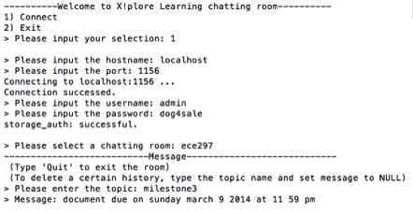
The Look of X!Plore
Notes:
figure needs to be explained

Slide 7
A feasible use case scenario
?
Username
Connect to Server
Choose Chat Room & Topic
Ask Question
Password
?
Username
Connect to Server
Choose Chat Room & Topic
Answer Question
Multiple
User
Enabled
Password
Log Out
?
Username
Connect to Server
Choose Chat Room & Topic
Search
Question
Password
?
Username
Connect to Server
Choose Chat Room & Topic
Delete
Question
Password

Slide 8
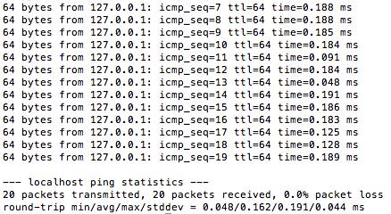
Design Decision: Background Knowledge
Connection Speed
64 bytes / 0.162 ms
= 50 chars / ms
Processing Speed
10 GFLOPS[1]
Screenshot of the round-trip testing
[1] "Nodes, Sockets, Cores and FLOPS, Oh, My," Dell Techcenter, Available: http://en.community.dell.com/techcenter/high-performance-computing/w/wiki/2329.aspx.

Slide 9
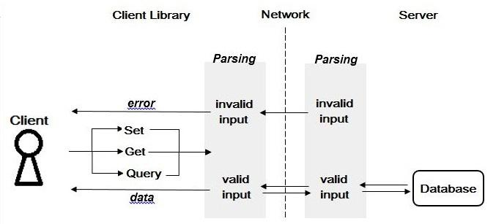
Design Decision: Parsing
(61%)
(33%)
(6%)

Slide 10
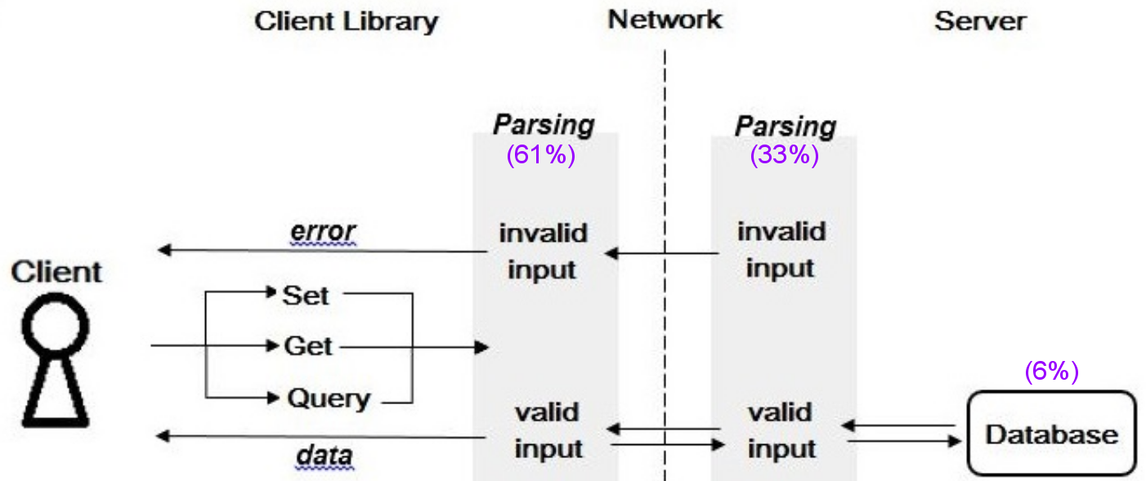
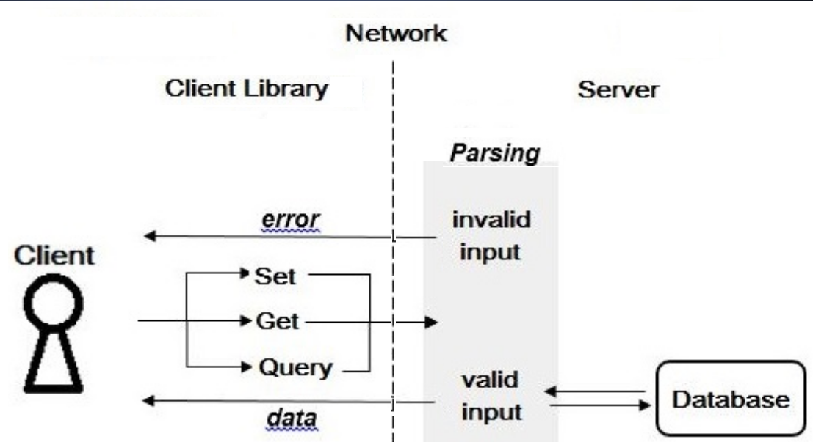
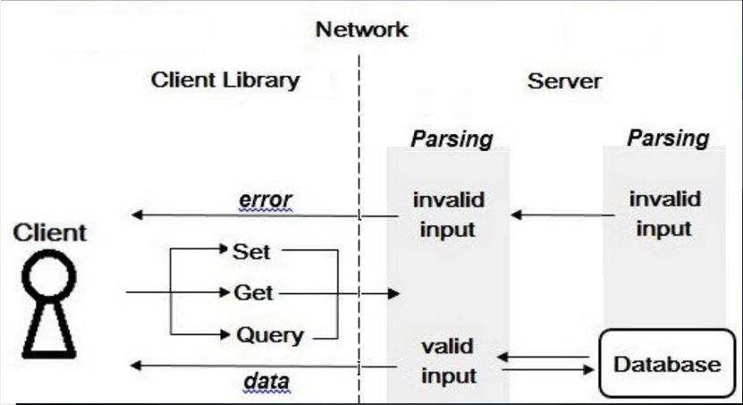
Design Decision: Parsing
pros
(if error) perform faster
error-free data arguments
minimum connection time
cons
(if error-free) more FLOPs
our
design
other
design
other
design

Slide 11
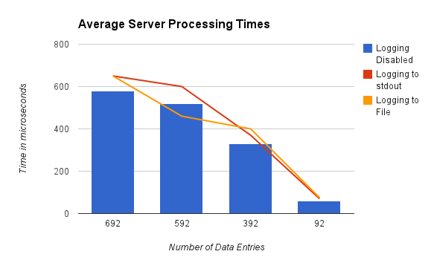
Performance Evaluation
Data operations
less than 1 μs each

Slide 12
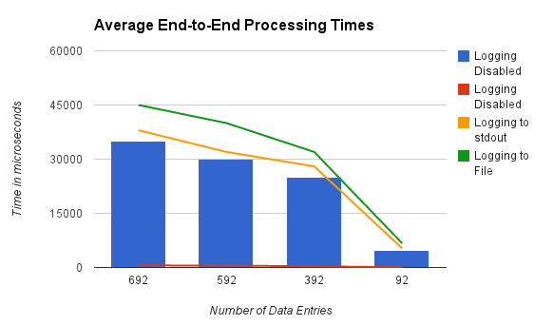
Performance Evaluation
Majority of execution time attributable to communication between the client and server processes !

Slide 13
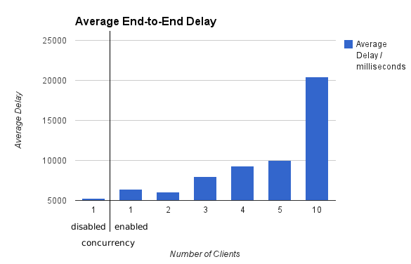
Performance Evaluation
Concurrency through multithreading
One thread per client
Baseline set - test w/ concurrency disabled
Overhead from implementing threads
Test with more clients from different machines
Increasing Delay

Slide 14
Summing Up
Adequate speed for seamless messaging in chat-room, achieved through:
Hash-hash table
Parsing
Scope for Improvement
Explore other communication mechanisms
Processes
select

